Slide 1
Name : Moguloju Sai Roll No : 20K91A6726 TKR College of Engineering and Technology, Hyderabad Cell : 9398053071 Email : saimoguloju2@gmail.com

Slide 2
Task - 1
Movement Patterns:
Predominant linear movement along major roads (NH9, outer ring road).
Localized activity within residential areas (sector 3).
Hotspots:
Intersection of NH9 and outer ring road.
Mangolpur khurd area.
Anomalies and Potential Threats:
Isolated movement outside the main road network near naharpur requires further investigation.
Increased activity in sector 3 warrants monitoring.
Recommendations:

Slide 3
Enhanced surveillance: Focus on hotspots, isolated movement points, and areas with concentrated activity.
Further investigation: Analyze historical data to establish baselines for movement patterns and identify anomalies.
Additional Considerations:
Data Quality: The accuracy and completeness of the data will significantly impact the analysis.
Time Factor: Understanding the time frame covered by the data is crucial for identifying patterns and anomalies.
Ground Truth Verification: On-ground verification can help corroborate the findings and identify potential discrepancies.

Slide 4
Task - 2
Movement Patterns:
Predominant linear movement along major roads (NH9, Outer Ring Road).
Localized activity within residential areas (Sector 3).
New: Concentrated activity around HL Parwana Road and Road Number 54.
Hotspots:
Intersection of NH9 and Outer Ring Road.
Mangolpur Khurd area.
New: Area around HL Parwana Road and Road Number 54.

Slide 5
Anomalies and Potential Threats:
Isolated movement outside the main road network near Naharpur requires further investigation.
Increased activity in Sector 3 warrants monitoring.
New: The concentrated activity around HL Parwana Road and Road Number 54 is an anomaly requiring further investigation.
Recommendations:
Enhanced surveillance: Focus on hotspots, isolated movement points, and areas with concentrated activity, especially around
HL Parwana Road and Road Number 54.Further investigation: Analyze historical data to establish baselines for movement patterns and identify anomalies.
Detailed analysis: Conduct in-depth analysis of the concentrated activity around HL Parwana Road and Road Number 54 to understand its nature and potential implications.

Slide 6
Task - 3
Movement Counts by Location and Type
This table summarizes the number of entries and exits recorded at each border post:
Location | Entry | Exit
Border Post Alpha | 3 | 2
Border Post Bravo | 3 | 3
Border Post Charlie | 3 | 3
Border Post Delta | 3 | 3
Border Post Echo | 3 | 3

Slide 7
Observations and Potential Insights
Border Post Echo consistently recorded more entries than exits, suggesting a potential imbalance in movement patterns.
There are periods of no recorded movement, particularly in March and May. This could be due to various factors such as data collection gaps or actual changes in activity levels.
Further analysis could involve calculating average daily movements, identifying peak movement periods, and comparing movement patterns across different border posts.

Slide 8
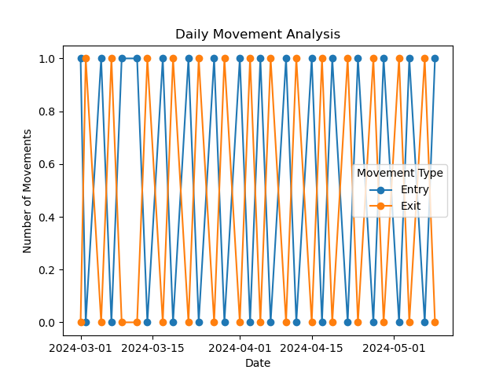
Temporal Analysis:

Slide 9
The image presents a line graph titled "Daily Movement Analysis." It visualizes the number of "Entry" and "Exit" movements over a period spanning from March 1, 2024, to May 1, 2024.
Key Elements:
Graph Type: A line graph with two lines representing "Entry" and "Exit" movements.
Axes:
X-axis: Represents time, with dates marked at intervals.
Y-axis: Represents the "Number of Movements," scaled from 0.0 to 1.0.
Data Points: The graph displays numerous data points connected by lines for both "Entry" and "Exit" movements.
Trend: Both lines fluctuate, showing peaks and valleys throughout the plotted period.
Legend: A box in the top right corner clarifies that the blue line signifies "Entry" movements and the orange line represents "Exit" movements.
Grid: A grid is present for better readability.

Slide 10
Overall Impression
The graph provides a clear visual representation of the daily fluctuations in "Entry" and "Exit" movements within the specified timeframe. The use of distinct lines and clear labeling enhances data interpretation.
Additional Considerations
Units: While the y-axis is labeled "Number of Movements," the specific units (e.g., count, percentage) are not explicitly mentioned.
Data Points: The exact number of data points is not visible due to the image resolution.
Context: The graph's context (e.g., what type of movements are being tracked) is not provided within the image itself.

Slide 11
Task - 4
Threat Assessment and Recommendations
Threat Assessment Summary:
Low-Level Activity: The data indicates consistent low-level activity at all border posts (Alpha, Bravo, Charlie, Delta, Echo) throughout the observed period (March 2024 - May 2024).
No Significant Trends: There are no apparent trends or patterns suggesting an increase or decrease in activity at any specific border post.
No High-Threat Events: No incidents with a high threat level were recorded during this timeframe.

Slide 12
Recommendations:
Maintain Vigilance: Continue monitoring activity at all border posts for any potential changes or anomalies.
Intelligence Gathering: Expand intelligence efforts to gather additional information on potential threats and actors operating in the region.
Cross-Border Collaboration: Enhance collaboration with neighboring countries to share information and coordinate counter-threat measures.
Technology Upgrades: Explore the use of advanced surveillance and detection technologies to improve border security.
Regular Assessment: Conduct periodic threat assessments to stay updated on the evolving situation.

